Slide 1

Цифровая и микроконтроллерная техника
Vlasov Sergey
smvlasov@itmo.ru

Slide 2
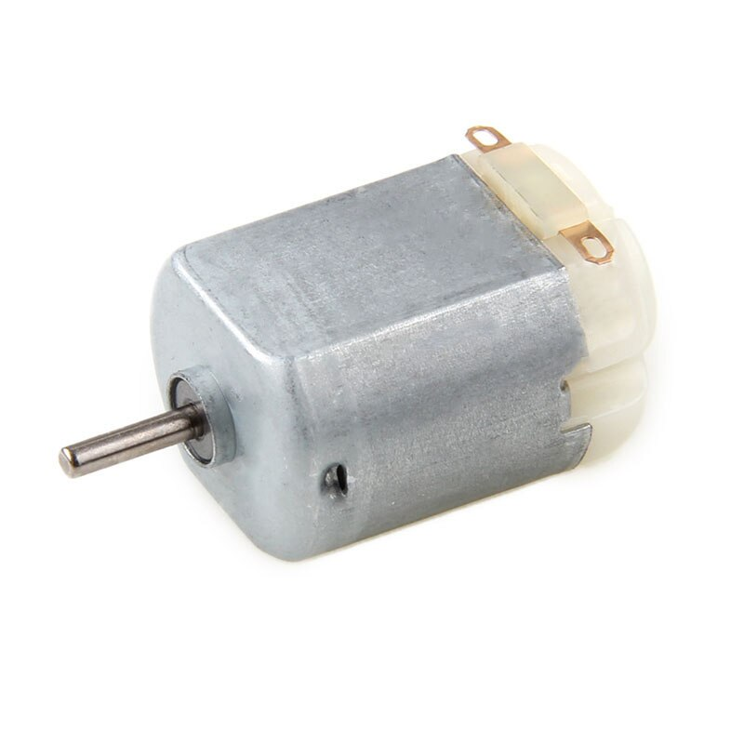
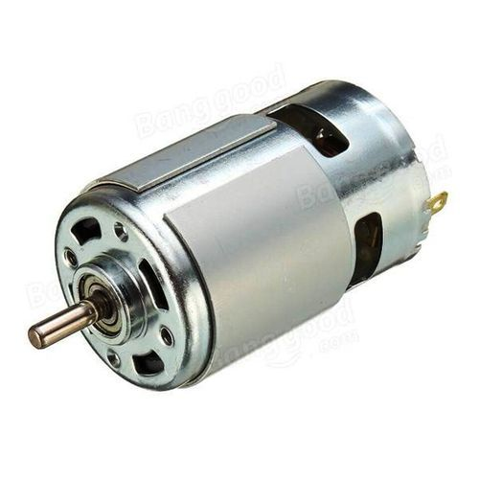
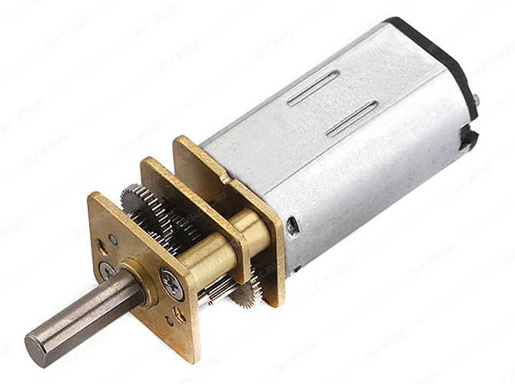
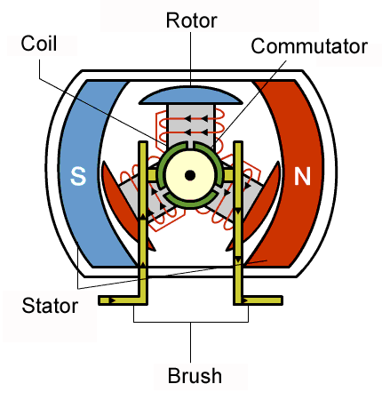
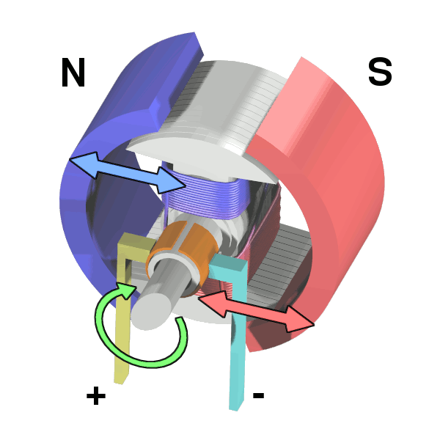
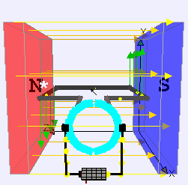
Brushed DC electric motor

Slide 3
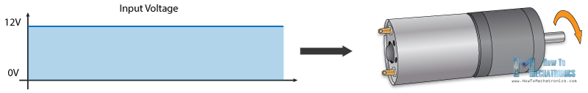
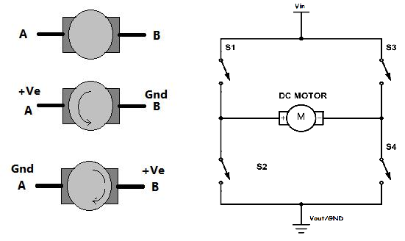
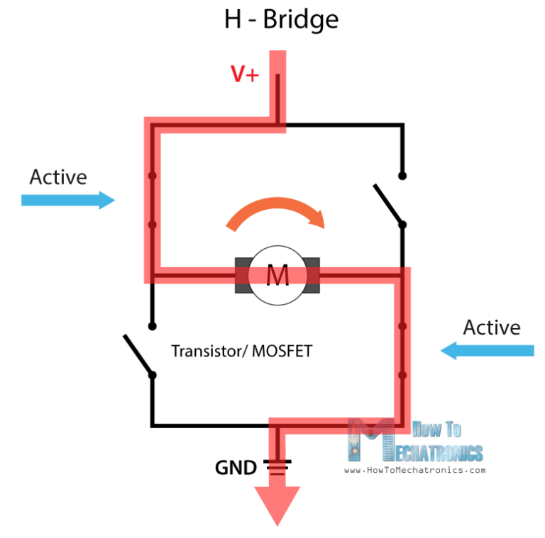
Motor controller

Slide 4
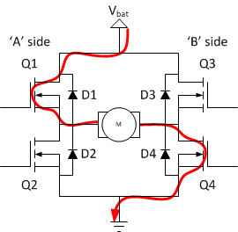
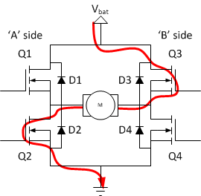
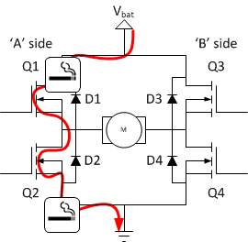
H-bridge

Slide 5
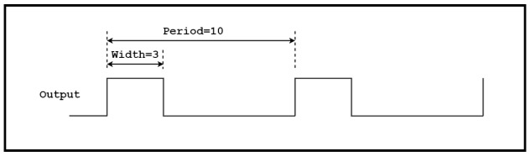
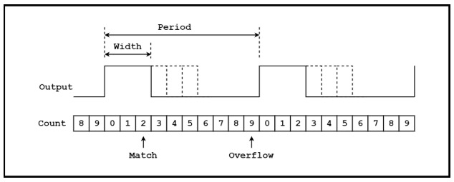
Pulse-width Modulation
$$\left(Width÷Period\right)×100=\left(3÷10\right)×100=30\%$$

Slide 6
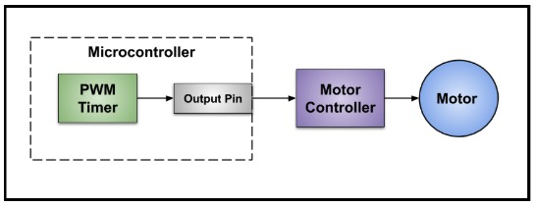
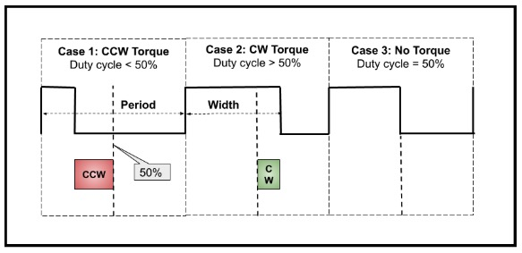
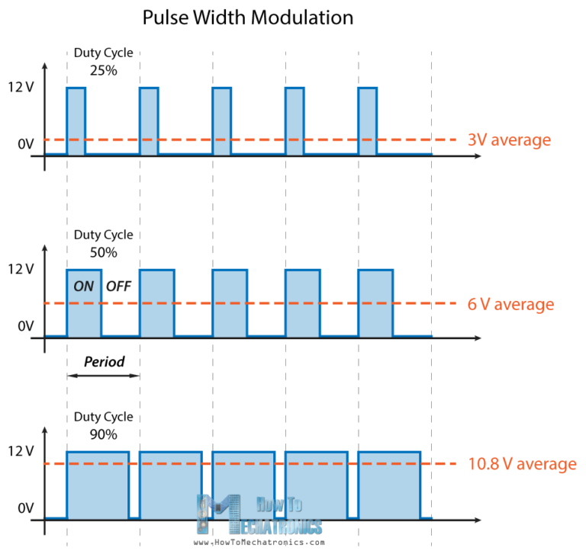
PWM Motor Control

Slide 7
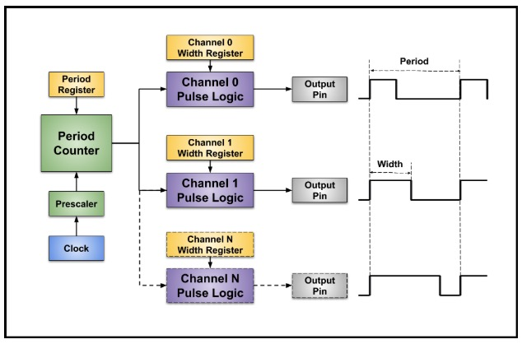
PWM timer
Period – ARR
Width – CCRx

Slide 8
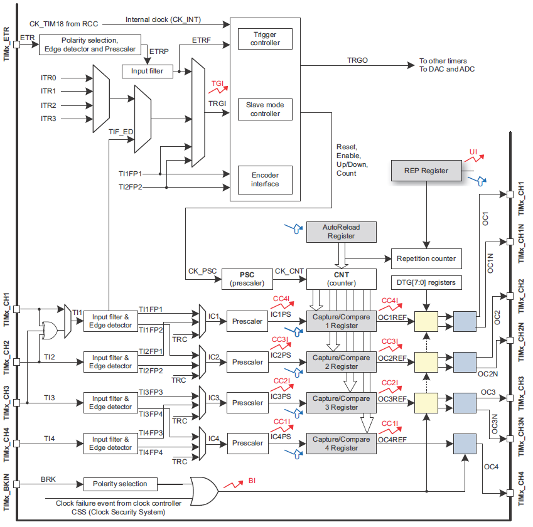
General-purpose timers

Slide 9
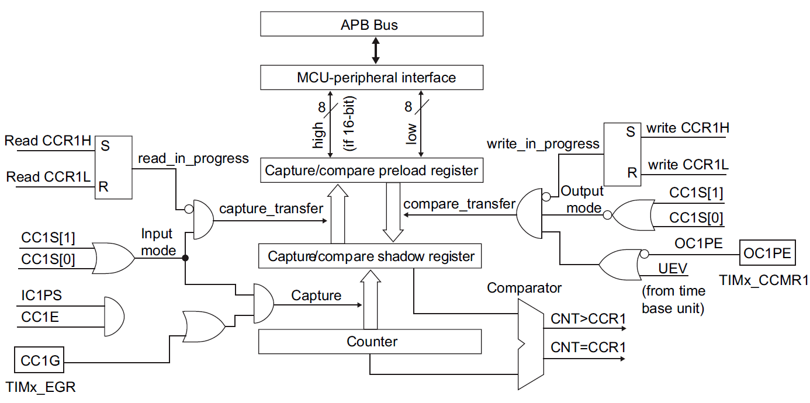
Capture/compare channels

Slide 10
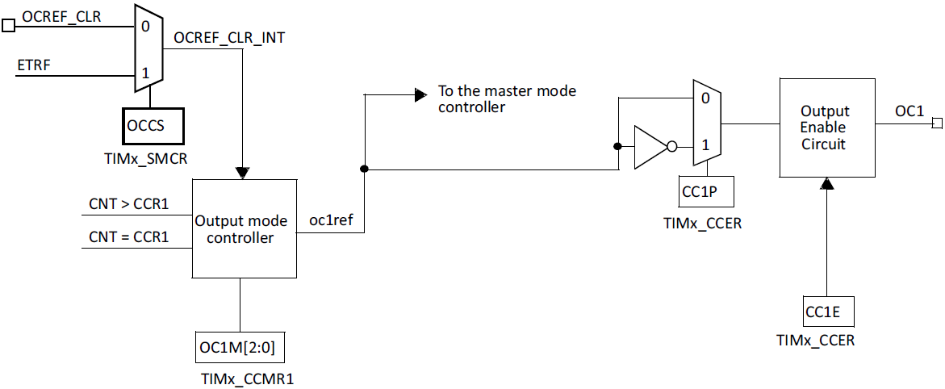
Capture/compare channels

Slide 11
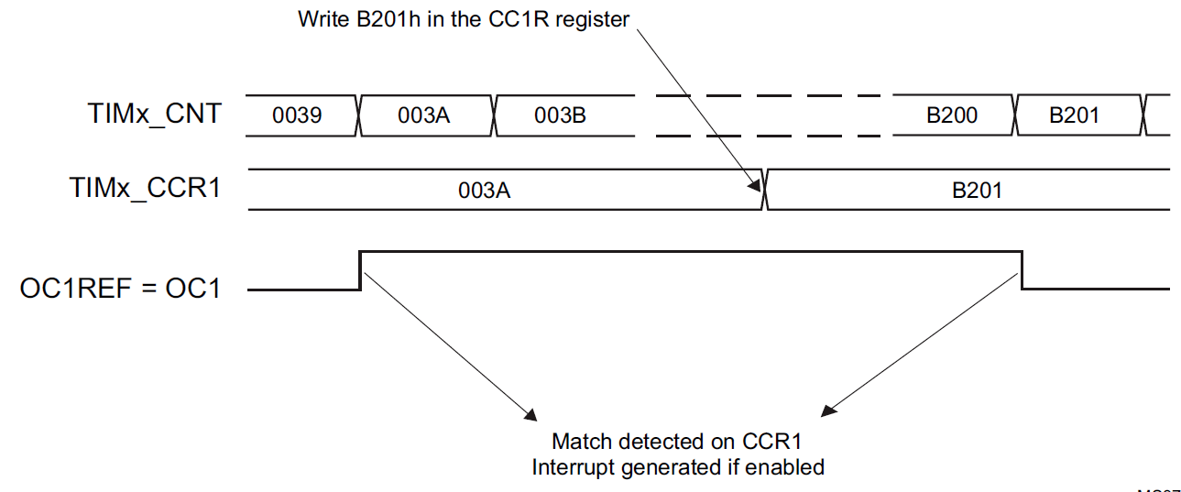
Output compare mode
1. Select the counter clock (internal, external, prescaler).
2. Write the desired data in the TIMx_ARR and TIMx_CCRx registers.
3. Set the CCxIE and/or CCxDE bits if an interrupt and/or a DMA request is to be generated.
4. Select the output mode. For example, you must write OCxM=011, OCxPE=0, CCxP=0 and CCxE=1 to toggle OCx output pin when CNT matches CCRx, CCRx preload is not used, OCx is enabled and active high.
5. Enable the counter by setting the CEN bit in the TIMx_CR1 register.

Slide 12
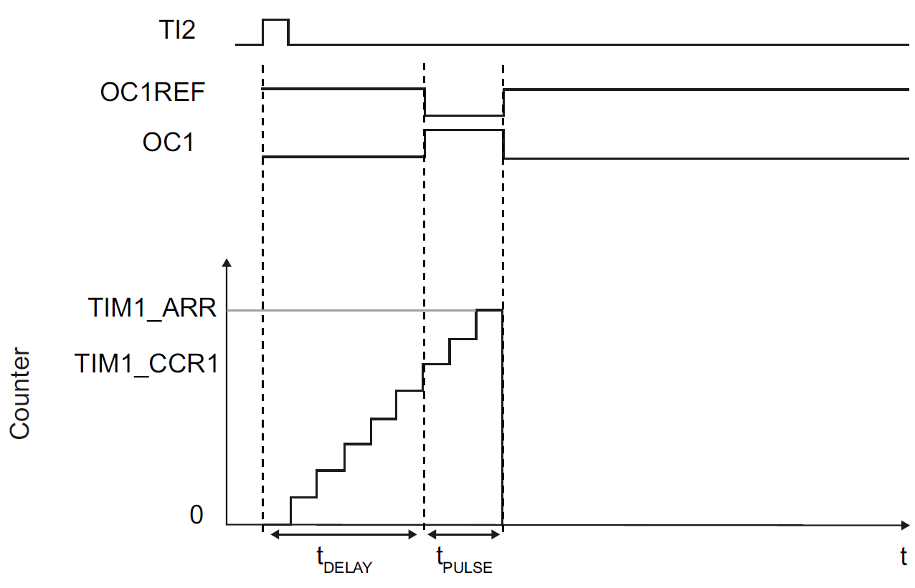
One pulse mode
upcounting
CNT<CCRx≤ARR

Slide 13
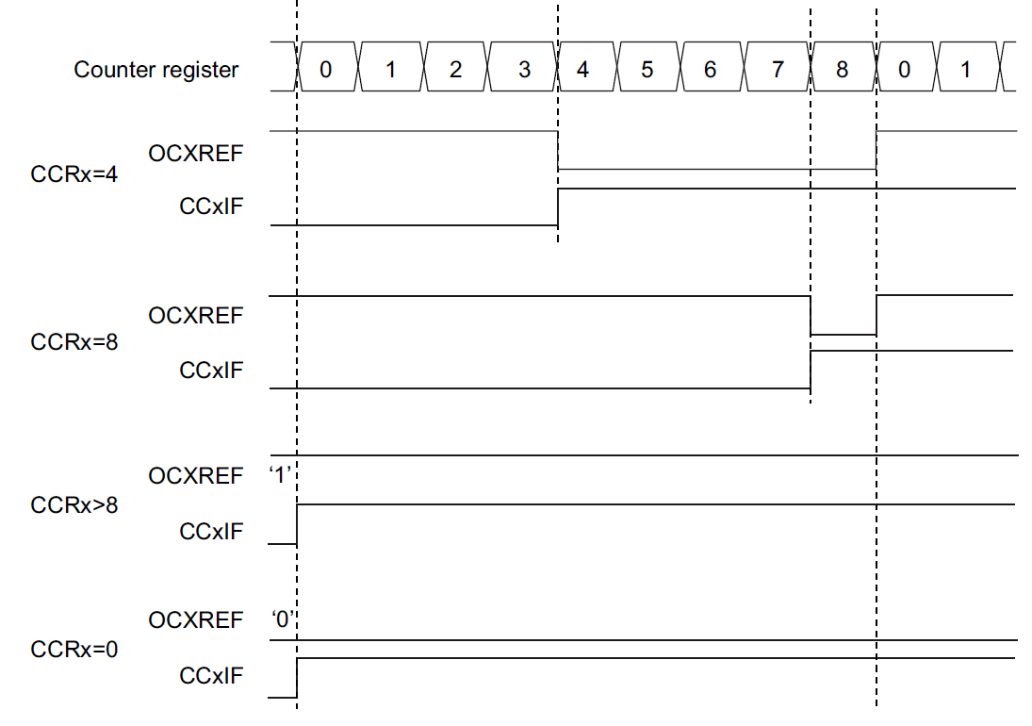
PWM
PWM mode 1
TIMx_CNT<TIMx_CCRx
ARR=8

Slide 14
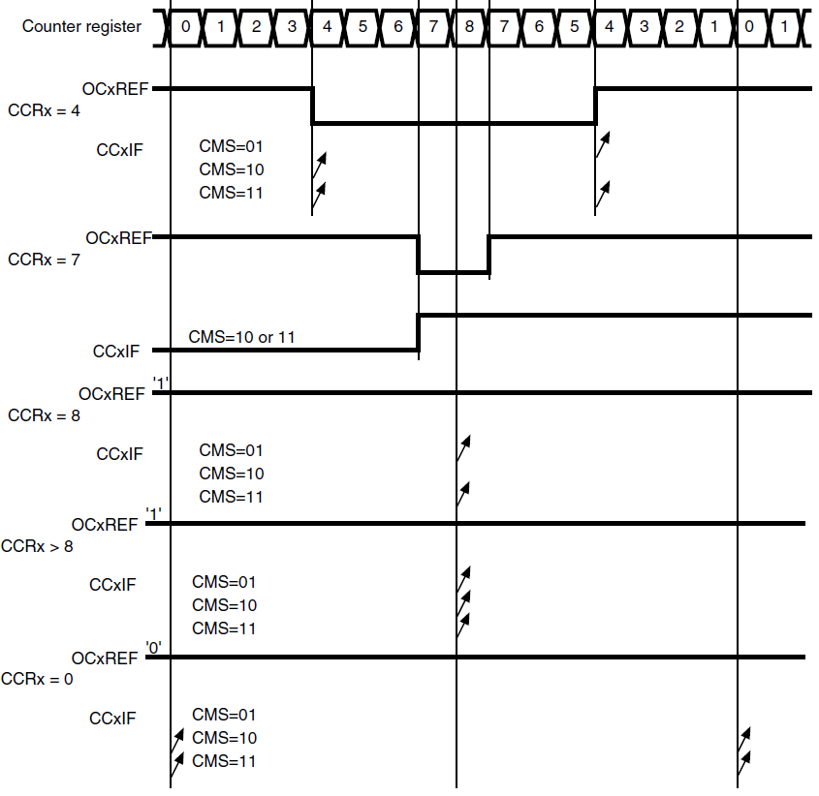
PWM center-aligned mode
PWM mode 1
ARR=8

Slide 15
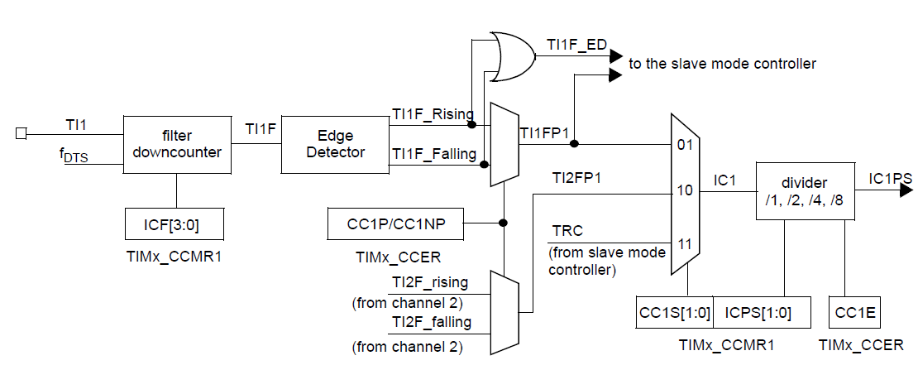
Capture/compare channels

Slide 16
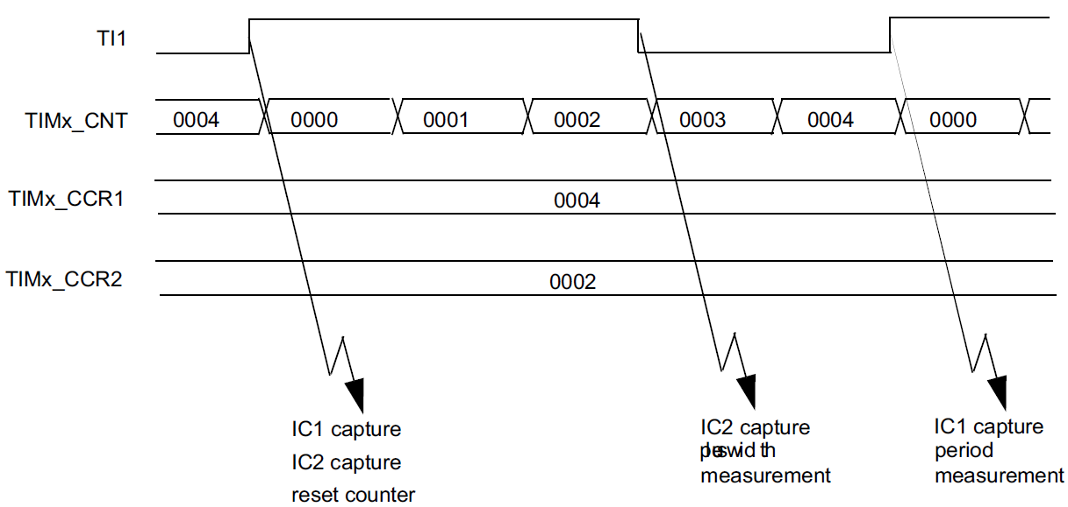
PWM input mode
• Select the active input for TIMx_CCR1: write the CC1S bits to 01 in the IMx_CCMR1 register (TI1 selected).
• Select the active polarity for TI1FP1 (used both for capture in TIMx_CCR1 and counter clear): write the CC1P to ‘0’ and the CC1NP bit to ‘0’ (active on rising edge).
• Select the active input for TIMx_CCR2: write the CC2S bits to 10 in the TIMx_CCMR1 register (TI1 selected).
• Select the active polarity for TI1FP2 (used for capture in TIMx_CCR2): write the CC2P bit to ‘1’ and the CC2NP bit to ’0’(active on falling edge).
• Select the valid trigger input: write the TS bits to 101 in the TIMx_SMCR register (TI1FP1 selected).
• Configure the slave mode controller in reset mode: write the SMS bits to 100 in the TIMx_SMCR register.
• Enable the captures: write the CC1E and CC2E bits to ‘1 in the TIMx_CCER register.

Slide 17
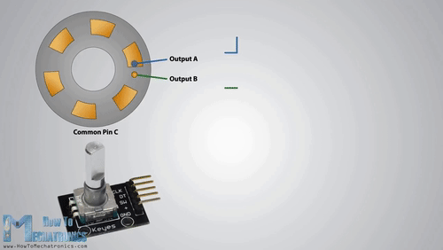
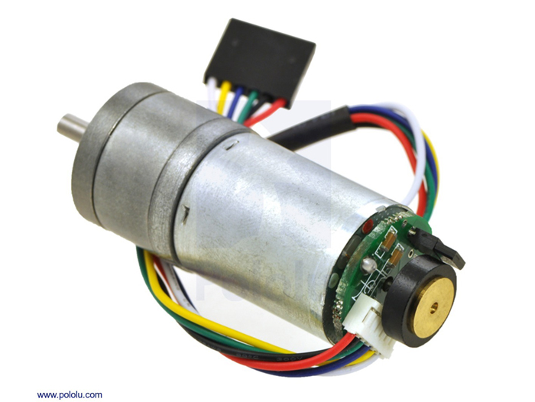
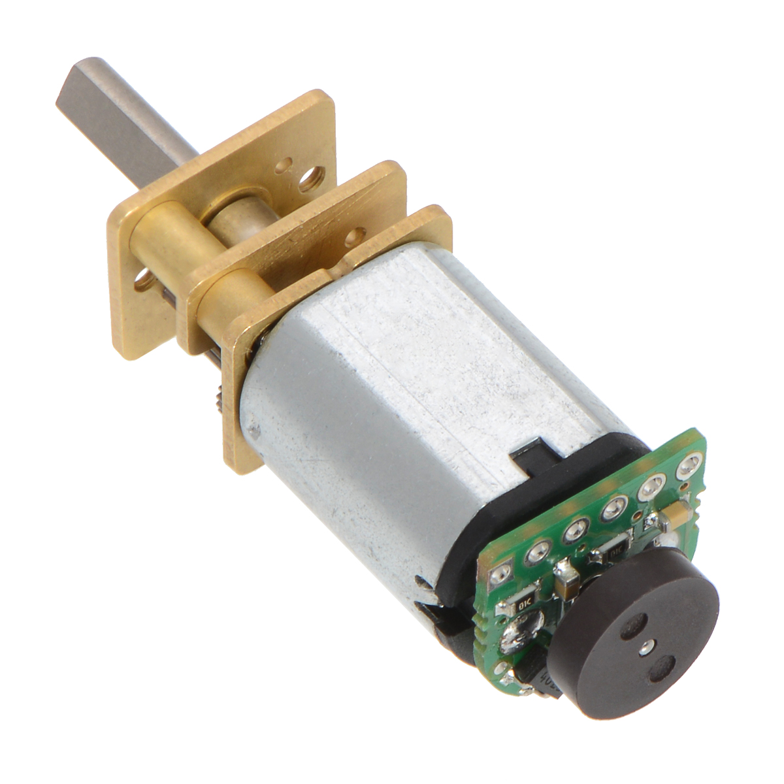
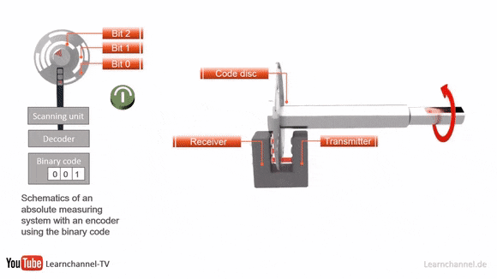
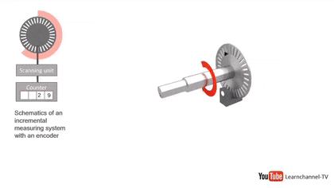
Encoders
Mechanical
Optical
Incremental
Absolute

Slide 18
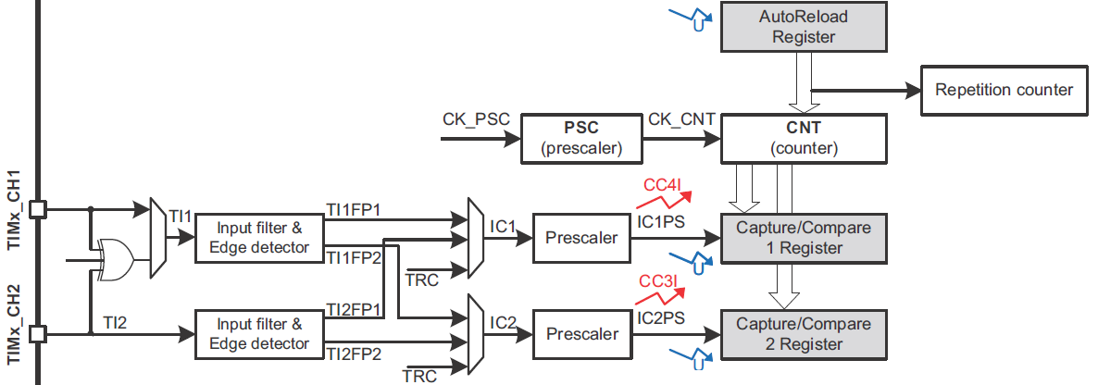
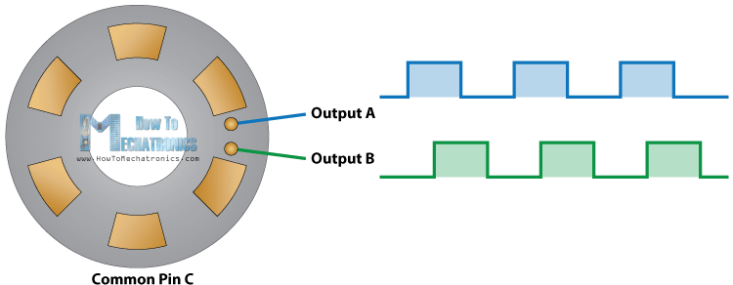
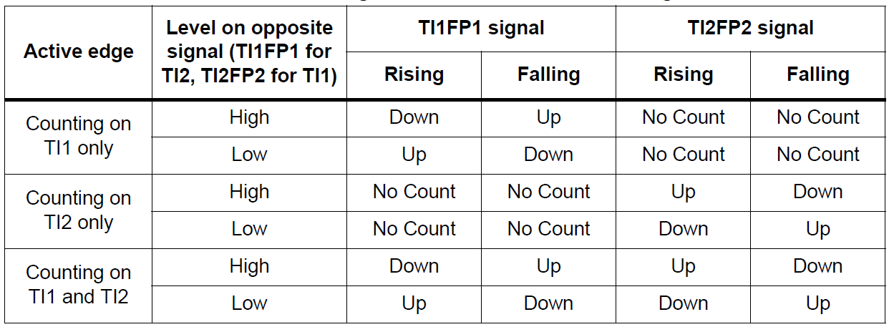
Encoder interface mode

Slide 19
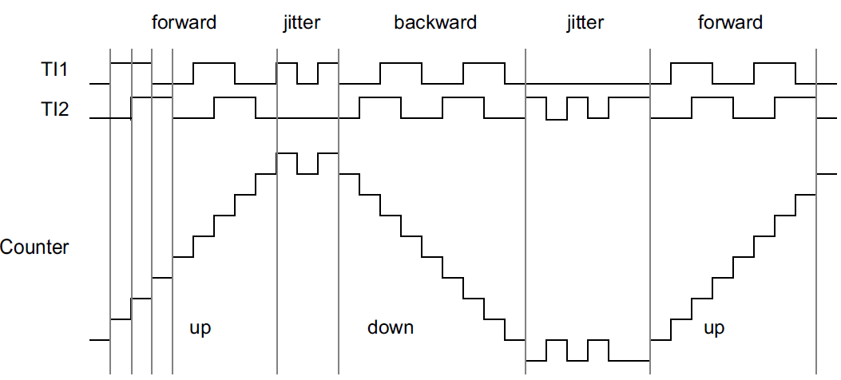
Encoder interface mode
• CC1S=’01’ (TIMx_CCMR1 register, TI1FP1 mapped on TI1).
• CC2S=’01’ (TIMx_CCMR2 register, TI1FP2 mapped on TI2).
• CC1P=’0’, CC1NP=’0’, and IC1F = ‘0000’ (TIMx_CCER register, TI1FP1 non-inverted, TI1FP1=TI1).
• CC2P=’0’, CC2NP=’0’, and IC2F = ‘0000’ (TIMx_CCER register, TI1FP2 non-inverted, TI1FP2= TI2).
• SMS=’011’ (TIMx_SMCR register, both inputs are active on both rising and falling edges).
• CEN=’1’ (TIMx_CR1 register, Counter enabled).

Slide 20
Timer’s registers
TIM control register 1 (TIMx_CR1)
TIM control register 2 (TIMx_CR2) TIM slave mode control register (TIMx_SMCR)
TIM DMA/interrupt enable register (TIMx_DIER)
TIM status register (TIMx_SR)
TIM event generation register (TIMx_EGR)
TIM capture/compare mode register 1/2 (TIMx_CCMR1/2) TIM capture/compare enable register (TIMx_CCER)
TIM counter (TIMx_CNT)
TIM prescaler (TIMx_PSC)
TIM auto-reload register (TIMx_ARR)
TIM repetition counter register (TIMx_RCR)
TIM capture/compare register 1-4 (TIMx_CCR1-4)
TIM break and dead-time register (TIMx_BDTR)
TIM DMA control register (TIMx_DCR)
TIM DMA address for full transfer (TIMx_DMAR)

Slide 21
Timer’s registers
TIM capture/compare enable register (TIMx_CCER) output mode
Address offset: 0x20
CC1E: Capture/Compare 1 output enable
0: Off - OC1 is not active. OC1 level is then function of MOE, OSSI, OSSR, OIS1, OIS1N and CC1NE bits.
1: On - OC1 signal is output on the corresponding output pin depending on MOE, OSSI, OSSR, OIS1, OIS1N and CC1NE bits.
CC1NE: Capture/Compare 1 complementary output enable
0: Off - OC1N is not active. OC1N level is then function of MOE, OSSI, OSSR, OIS1, OIS1N and CC1E bits.
1: On - OC1N signal is output on the corresponding output pin depending on MOE, OSSI, OSSR, OIS1, OIS1N and CC1E bits.
CC1P: Capture/Compare 1 output polarity
0: OC1 active high
1: OC1 active low
CC1NP: Capture/Compare 1 complementary output polarity
0: OC1N active high.
1: OC1N active low.

Slide 22
Timer’s registers
TIM capture/compare enable register (TIMx_CCER) input mode
Address offset: 0x20
CC1E: Capture/Compare 1 output enable
This bit determines if a capture of the counter value can actually be done into the input capture/compare register 1 (TIMx_CCR1) or not.
0: Capture disabled.
1: Capture enabled.
CC1NP: Capture/Compare 1 complementary output polarity
This bit is used in conjunction with CC1P to define the polarity of TI1FP1 and TI2FP1. Refer to CC1P description
CC1P: Capture/Compare 1 output polarity
CC1NP/CC1P bits select the active polarity of TI1FP1 and TI2FP1 for trigger or capture operations.
00: non-inverted/rising edge
The circuit is sensitive to TIxFP1 rising edge (capture or trigger operations in reset, external clock or trigger mode), TIxFP1 is not inverted (trigger operation in gated mode or encoder mode).
01: inverted/falling edge
The circuit is sensitive to TIxFP1 falling edge (capture or trigger operations in reset, external clock or trigger mode), TIxFP1 is inverted (trigger operation in gated mode or encoder mode).
10: reserved, do not use this configuration.
11: non-inverted/both edges
The circuit is sensitive to both TIxFP1 rising and falling edges (capture or trigger operations in reset, external clock or trigger mode), TIxFP1 is not inverted (trigger operation in gated mode). This configuration must not be used in encoder mode.

Slide 23
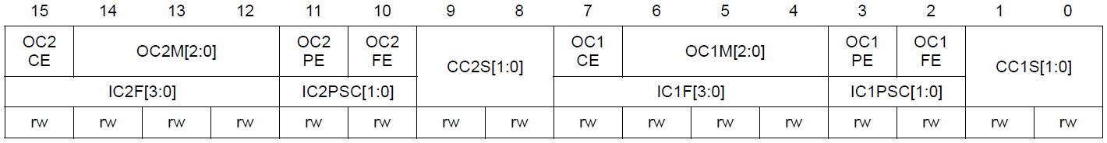
Timer’s registers
TIM capture/compare mode register 1/2 (TIMx_CCMR1/2)
Address offset: 0x18, 0x1C
CC1S: Capture/Compare 1 selection
This bit-field defines the direction of the channel (input/output) as well as the used input.
00: CC1 channel is configured as output
01: CC1 channel is configured as input, IC1 is mapped on TI1
10: CC1 channel is configured as input, IC1 is mapped on TI2
11: CC1 channel is configured as input, IC1 is mapped on TRC. This mode is working only if an internal trigger input is selected through TS bit (TIMx_SMCR register)
CC2S: Capture/Compare 2 selection
This bit-field defines the direction of the channel (input/output) as well as the used input.
00: CC2 channel is configured as output
01: CC2 channel is configured as input, IC2 is mapped on TI2
10: CC2 channel is configured as input, IC2 is mapped on TI1
11: CC2 channel is configured as input, IC2 is mapped on TRC. This mode is working only if an internal trigger input is selected through the TS bit (TIMx_SMCR register)

Slide 24
Timer’s registers
TIM capture/compare mode register 1/2 (TIMx_CCMR1/2) output mode
Address offset: 0x18, 0x1C
OC1M: Output Compare 1 mode
These bits define the behavior of the output reference signal OC1REF from which OC1 and OC1N are derived. OC1REF is active high whereas OC1 and OC1N active level depends on CC1P and CC1NP bits.
000: Frozen - The comparison between the output compare register TIMx_CCR1 and the counter TIMx_CNT has no effect on the outputs.(this mode is used to generate a timing base).
001: Set channel 1 to active level on match. OC1REF signal is forced high when the counter TIMx_CNT matches the capture/compare register 1 (TIMx_CCR1).
010: Set channel 1 to inactive level on match. OC1REF signal is forced low when the counter TIMx_CNT matches the capture/compare register 1 (TIMx_CCR1).
011: Toggle - OC1REF toggles when TIMx_CNT=TIMx_CCR1.
100: Force inactive level - OC1REF is forced low.
101: Force active level - OC1REF is forced high.
110: PWM mode 1 - In upcounting, channel 1 is active as long as TIMx_CNT<TIMx_CCR1 else inactive. In downcounting, channel 1 is inactive (OC1REF=‘0’) as long as TIMx_CNT>TIMx_CCR1 else active (OC1REF=’1’).
111: PWM mode 2 - In upcounting, channel 1 is inactive as long as TIMx_CNT<TIMx_CCR1 else active. In downcounting, channel 1 is active as long as TIMx_CNT>TIMx_CCR1 else inactive.

Slide 25
Timer’s registers
TIM capture/compare mode register 1/2 (TIMx_CCMR1/2) input mode
Address offset: 0x18, 0x1C
IC1PSC: Input capture 1 prescaler
This bit-field defines the ratio of the prescaler acting on CC1 input (IC1).
The prescaler is reset as soon as CC1E=’0’ (TIMx_CCER register).
00: no prescaler, capture is done each time an edge is detected on the capture input
01: capture is done once every 2 events
10: capture is done once every 4 events
11: capture is done once every 8 events
IC1F: Input capture 1 filter
This bit-field defines the frequency used to sample TI1 input and the length of the digital filter applied to TI1. The digital filter is made of an event counter in which N consecutive events are needed to validate a transition on the output:
0000: No filter, sampling is done at fDTS
0001: fSAMPLING=fCK_INT, N=2
0010: fSAMPLING=fCK_INT, N=4
0011: fSAMPLING=fCK_INT, N=8
0100: fSAMPLING=fDTS/2, N=6
0101: fSAMPLING=fDTS/2, N=8
0110: fSAMPLING=fDTS/4, N=6
0111: fSAMPLING=fDTS/4, N=8
1000: fSAMPLING=fDTS/8, N=6
1001: fSAMPLING=fDTS/8, N=8

Slide 26
Timer’s registers
TIM break and dead-time register (TIMx_BDTR)
Address offset: 0x44
MOE: Main output enable
This bit is cleared asynchronously by hardware as soon as the break input is active. It is set by software or automatically depending on the AOE bit. It is acting only on the channels which are configured in output.
0: OC and OCN outputs are disabled or forced to idle state.
1: OC and OCN outputs are enabled if their respective enable bits are set (CCxE, CCxNE in TIMx_CCER register).

Slide 27
Timer’s registers
TIM capture/compare register 1/2/3/4 (TIMx_CCR1/2/3/4)
Address offset: 0x34, 0x38, 0x3C, 0x40
CCR1: Capture/Compare 1 value
If channel CC1 is configured as output:
CCR1 is the value to be loaded in the actual capture/compare 1 register (preload value).
It is loaded permanently if the preload feature is not selected in the TIMx_CCMR1 register (bit OC1PE). Else the preload value is copied in the active capture/compare 1 register when an update event occurs.
The active capture/compare register contains the value to be compared to the counter TIMx_CNT and signaled on OC1 output.
If channel CC1 is configured as input:
CCR1 is the counter value transferred by the last input capture 1 event (IC1).

Slide 28
Timer’s registers
TIM slave mode control register (TIMx_SMCR)
Address offset: 0x08
SMS: Slave mode selection
When external signals are selected the active edge of the trigger signal (TRGI) is linked to the polarity selected on the external input (see Input Control register and Control Register description.
000: Slave mode disabled - if CEN = ‘1’ then the prescaler is clocked directly by the internal clock.
001: Encoder mode 1 - Counter counts up/down on TI2FP2 edge depending on TI1FP1 level.
010: Encoder mode 2 - Counter counts up/down on TI1FP1 edge depending on TI2FP2 level.
011: Encoder mode 3 - Counter counts up/down on both TI1FP1 and TI2FP2 edges depending on the level of the other input.
100: Reset Mode - Rising edge of the selected trigger input (TRGI) reinitializes the counter and generates an update of the registers.
101: Gated Mode - The counter clock is enabled when the trigger input (TRGI) is high. The counter stops (but is not reset) as soon as the trigger becomes low. Both start and stop of the counter are controlled.
110: Trigger Mode - The counter starts at a rising edge of the trigger TRGI (but it is not reset). Only the start of the counter is controlled.
111: External Clock Mode 1 - Rising edges of the selected trigger (TRGI) clock the counter.

Slide 29
PWM set algorithm
Steps for PWM generation
Set timer prescaler value.
Set Auto-reload register value.
Enable channel in capture/compare enable register.
Set mode for channel in capture/compare mode register.
Enable master output if required.
Set capture/compare register value.
Enable timer.

Slide 30
Encoder mode enable algorithm
Steps for take data from encoder
Set mode for channels in capture/compare mode register.
Set polarity if required in capture/compare enable register.
Set mode in slave mode control register.
Set Auto-reload register.
Reset counter value.
Enable timer.

Slide 31

Thank you for attention
www.ifmo.ru

